Slide 1
Welcome to the Belgian UserCon!

Slide 2

Welcome to the Belgian UserCon!
Link to Presentation on my GitHub
Matt Heldstab
Systems Engineer – Minnesota State Colleges and Universities
Tales from a Broadcom Customer in 2025
Architecture, Licensing Stories and Professional Development Planning

Slide 3
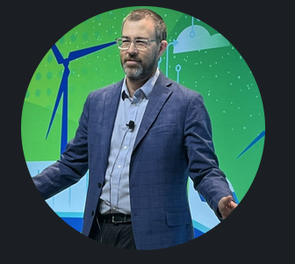

Tales from a Broadcom Customer in 2025
Let’s Connect!
Matt Heldstab
Current VMUG Vice President, Minneapolis VMUG Leader
Systems Engineer – Minnesota State Colleges and Universities
Contact: matt@tcwd.net -- @mattheldstab on TwiX
LinkedIn: https://www.linkedin.com/in/matt-heldstab-27387a6/
BlueSky: @vmatt.net Blog: www.vmatt.net

Slide 4
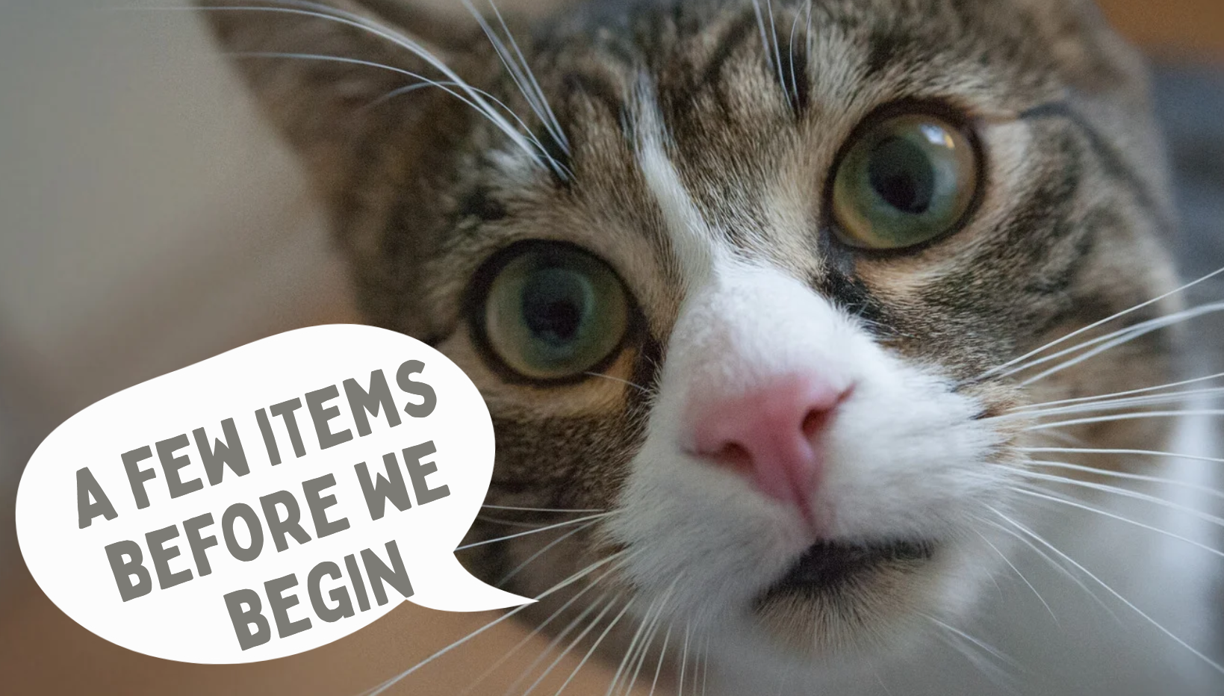
Tales from a Broadcom Customer in 2025
Level-Set
Time permitting, I would like this to be interactive
I am not a Broadcom employee
This presentation has not been vetted or approved by VMUG, Broadcom, or Omnissa
Examples in this presentation are real-world examples and might not be what you experience. As they say, your mileage may vary.

Slide 5
Tales from a Broadcom Customer in 2025
Agenda
Where we started at Minnesota State
Discovering the new normal at Broadcom
Understanding the new product landscape
Choosing a level that works for your company
What NOT to do
Architecture changes you can make to reduce the cost of your next agreement
Using Broadcom and VMUG’s new partnership to assist with Professional Development

Slide 6
Our Story

Slide 7
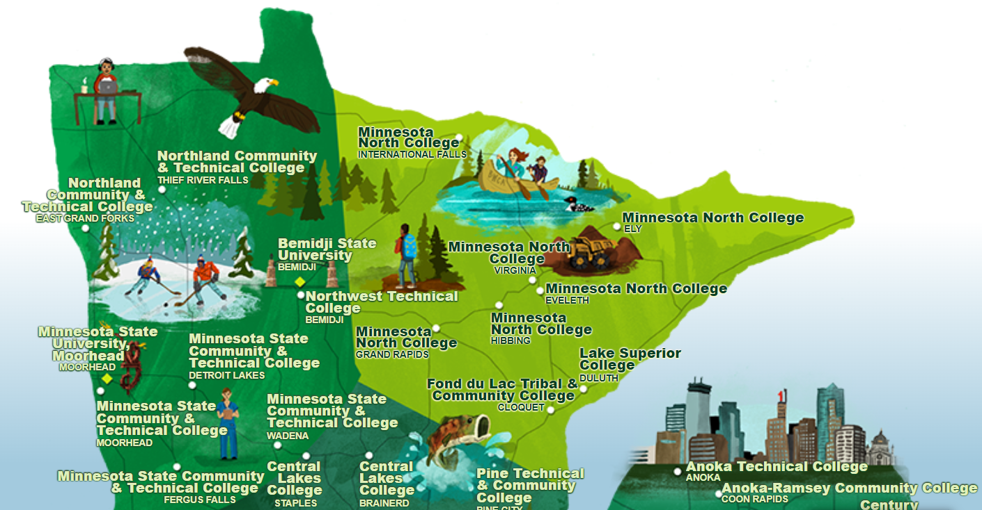
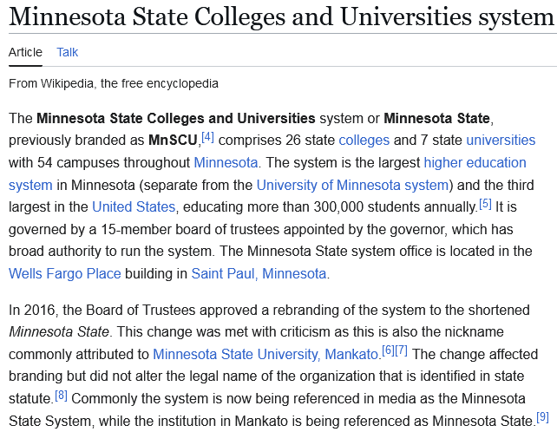
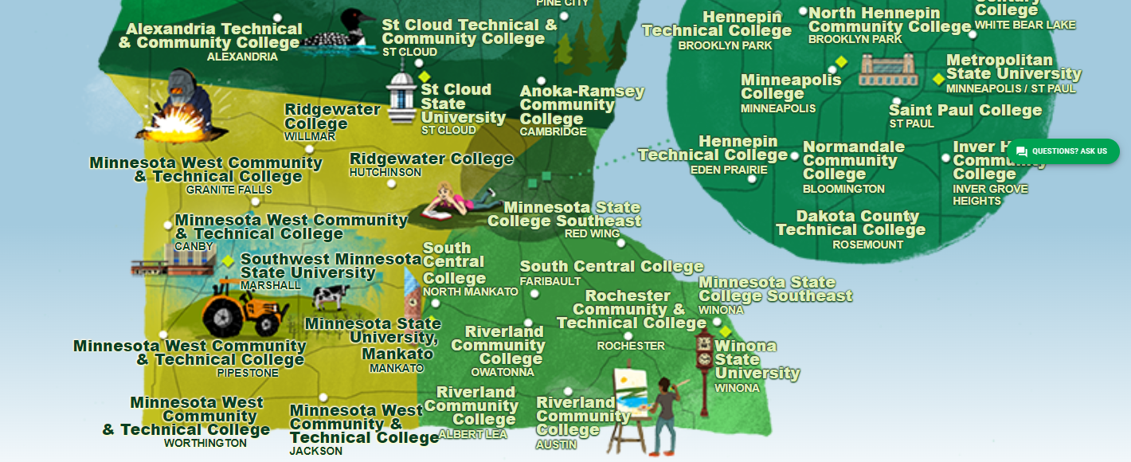
Tales from a Broadcom Customer in 2025

Slide 8
Tales from a Broadcom Customer in 2025
Right-sizing over the years at Minnesota State
We began our Managed Service Practice in 2016
Our on-premises infrastructure included:
26 IBM Blades
38 HP Blades
17 HP Rack-mount Servers
9 Datacenters
From that first ELA in 2016 to present (approximately the same amount of workloads)
80 ESXi Hosts overall

Slide 9
Better performing servers that run more dense
64GB to 256GB to 1TB+ memory per host
Workloads not CPU-bound
Online Learning System – migrate to SaaS
Microsoft Exchange to Microsoft 365 migration
Load Balancers – Migrated from dedicated to shared ESXi
Public web presence – Migrated to Azure
Upcoming Migration to Workday
Increased Minimum Req’ss for server operating systems
Increased Minimum Req’s for desktop OS’s XP to 7 to 10 to 11
Remote Access post-pandemic (Horizon)
Custom software appliance instances on the rise
Exponential increase of Cisco, Palo Alto, VMware appliance specs
Migration from SUSE Linux to MS Windows
A few IaaS apps repatriated due to DBaaS performance issues

Slide 10
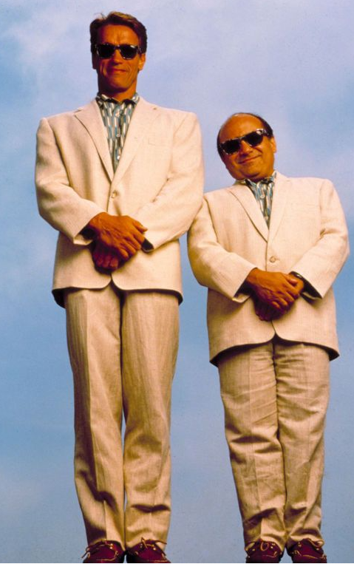
Tales from a Broadcom Customer in 2025
Right-sizing over the years at Minnesota State
Where we are at in 2025 – 9 years later
Our on-premises infrastructure includes:
21 Dell MX Blades
4 Dell PowerEdge Rack-mount
13 HP Rack-mount
9 Datacenters
38 ESXi Hosts overall

Slide 11
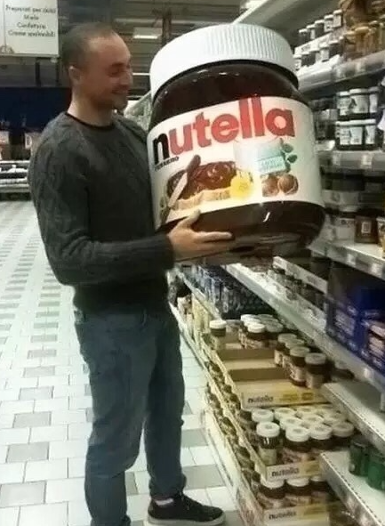
Tales from a Broadcom Customer in 2025
Entering your next contract agreement - tips
Consider right-sizing
Compute vendors – but THIS CPU is only a little more!
Make sure your first quote is post-right-sized!!!
My campus stories
This is something we have all been doing for years

Slide 12
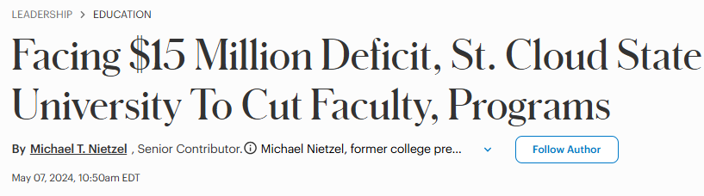
Tales from a Broadcom Customer in 2025
Entering your next contract agreement - tips
Show evidence of hardship if that is the case Especially if it is in the news.
If you don’t need VCF, consider asking for a quote anyway – it might actually be cheaper
Play the “partnership card”
Broadcom has been known to reward those who view them as a strategic partner.
Understand the product and feature set well

Slide 13

Tales from a Broadcom Customer in 2025
Where WE started at Minnesota State
Start the conversation early and stay positive
Seriously consider your attitude when you start negotiating
Should be a no-brainer that a civil conversation can only help the situation
Broadcom looks favorably upon those who participate in the vCommunity
If you have presented at a VMUG let your team know!

Slide 14
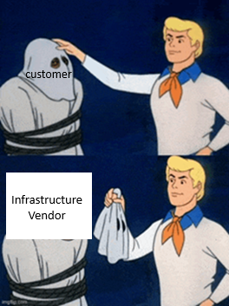
Tales from a Broadcom Customer in 2025
Do your homework
Some redditors are vendors trying to generate FUD
Some are actual customers not telling the whole story
Some negative stories are actually true but the fake ones are often easy to identify
Reddit is a “venting” platform not unlike much social media. Customers won’t be as apt to post success stories but you can find some gems.

Slide 15

Tales from a Broadcom Customer in 2025
Did someone
say Reddit?

Slide 16

Tales from a Broadcom Customer in 2025
Do your homework
Industry chaos is an opportunity for many
Work with your account team
Find out what is possible
Speaking of Reddit – I found this tidbit there Ohio OARnet – (Some contracts are publicly available) https://www.oar.net/content/product_details_and_pricing

Slide 17
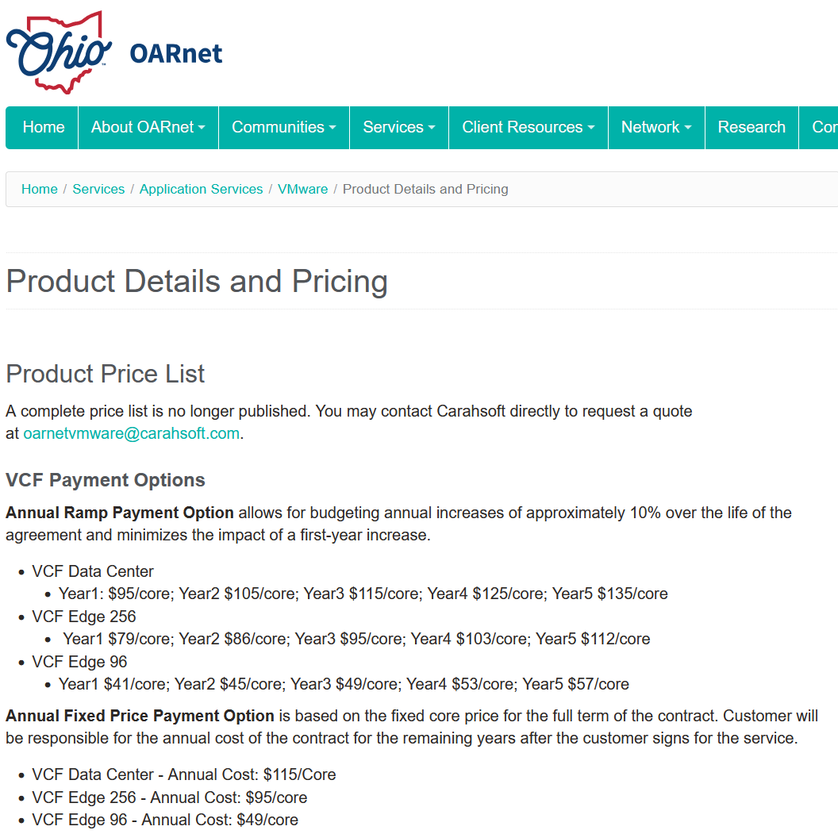

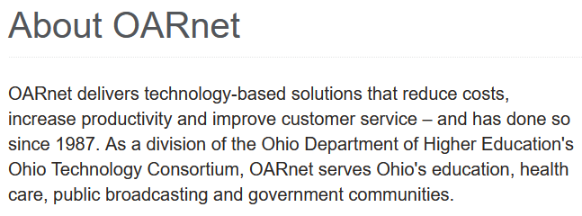
Tales from a Broadcom Customer in 2025
Ohio Contract Details
Positives: VCF at $115/core/yr
33% of retail price
Negatives: Standard, Enterprise plus and VVF not available

Slide 18
Tales from a Broadcom Customer in 2025
Current Products
VMware Cloud Foundation (VCF)
VMware Cloud Foundation - Edge
VMware vSphere Foundation (VVF)
VMware vSphere Enterprise Plus
VMware vSphere Standard

Slide 19
Tales from a Broadcom Customer in 2025
Current Products
VMware Cloud Foundation (VCF)
VMware Cloud Foundation - Edge
VMware vSphere Foundation (VVF)
VMware vSphere Enterprise Plus
VMware vSphere Standard
VMware vSphere Foundation for VDI (VVF for VDI)
Attn Omnissa
Customers!

Slide 20
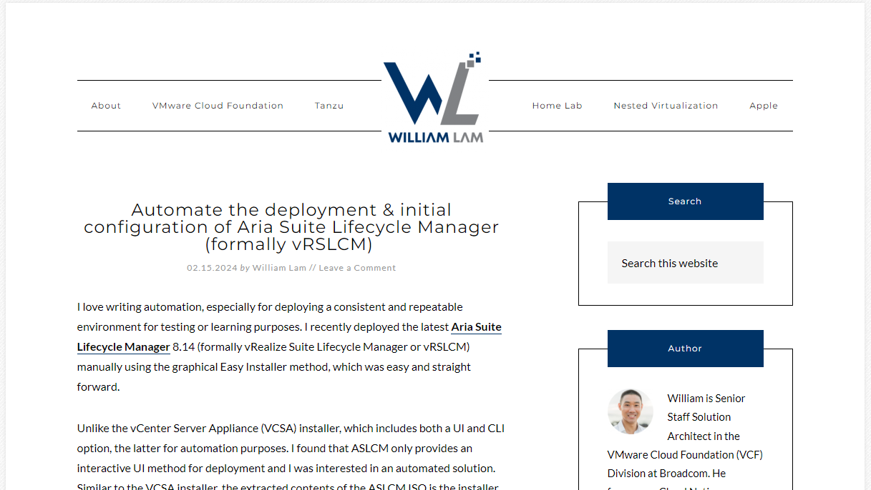
Tales from a Broadcom Customer in 2025
William Lam is a fantastic resource – www.williamlam.com

Slide 21
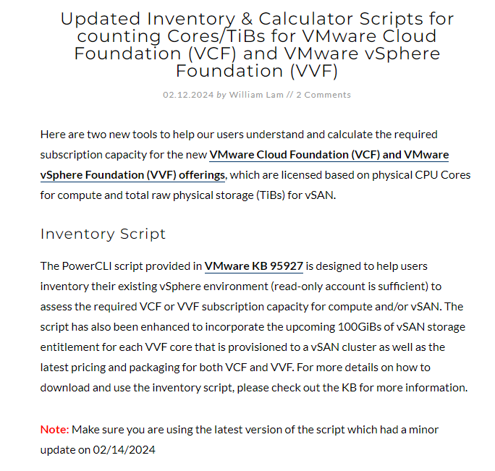
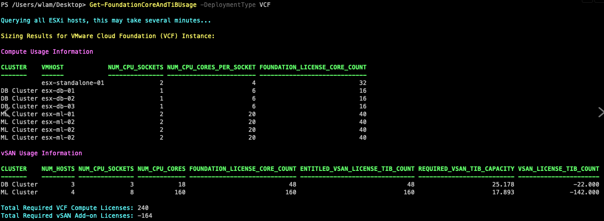
Tales from a Broadcom Customer in 2025
How do I know how many cores I need to buy in my next agreement?
https://williamlam.com/2024/02/updated-inventory-calculator-scripts-for-counting-cores-tibs-for-vmware-cloud-foundation-vcf-and-vmware-vsphere-foundation-vvf.html

Slide 22
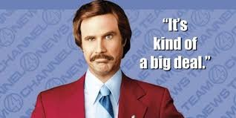
Tales from a Broadcom Customer in 2025
Level-set -- VMware Cloud Foundation – YOU GUYS KNOW THE STORY
VCF is a best-in class suite of products that comprise the Software-Defined Datacenter
VCF will absolutely transform your datacenter, especially if you need to
Streamline the deployment of VMware products
Eliminate configuration inconsistencies that come with manual deployments
Standardize how infrastructure is deployed
Bring cloud methods into your on-premises datacenter
Integrate with other VMware Cloud products such as VMC on AWS, AVS, OCVS, GCVE
If your organization can afford VCF, you won’t be sorry. Just understand that the technology is more expensive than other editions of vSphere.
This presentation will discuss what some of the differences are, and compare it to other products that are available.
VCF you say?

Slide 23
Tales from a Broadcom Customer in 2025
Retail Price
$350/core/year
Minimum 16 cores
Per socket
VMware Cloud Foundation (VCF)
Entitles you to the entire Software-Defined Datacenter
Included vSphere Enterprise Plus-level features plus vCenter Server Standard
Entitles you to 1TiB/core RAW of VSAN
Only licensing level that provides NSX, entire Aria Suite (Ops, Logs, Auto, Network) vCloud Director (available add-ons for Distributed FW, IDS/IPS)
Direct-to-Broadcom support
Annual Billing
Free education / training in customer Broadcom portal

Slide 24
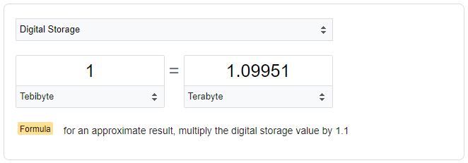
Tales from a Broadcom Customer in 2025
Retail Price
$350/core/year
Minimum 16 cores
Per socket
Measuring VSAN Entitlements
Important stuff to know
TiB not TB – Tebibytes not Terabytes
RAW not Usable
1000 cores of VCF = 1099.51 TB

Slide 25
Tales from a Broadcom Customer in 2025
Retail Price
$190/core/year (1y)
$150/core/year (3y)
Minimum 16 cores
Per socket
VMware vSphere Foundation (VVF)
Entitles you to 250GiB/core RAW of VSAN
Included: vSphere Enterprise Plus-level features, vCenter, Aria Ops Standard and Logs
Not Included: NSX, Aria Auto, Ops Enterprise, Network
Third-Party Support only
3 year deal, paid up-front
Education not included
Pricing is minimally negotiable

Slide 26
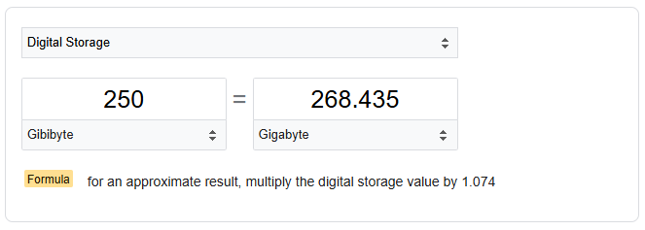
Tales from a Broadcom Customer in 2025
Retail Price
$190/core/year (1y)
$150/core/year (3y)
Minimum 16 cores
Per socket
Measuring VSAN Entitlements
Important stuff to know
GiB not GB – Gibibytes not Gigabytes
RAW not Usable
1000 cores of VVF = 268.435 TB

Slide 27
Tales from a Broadcom Customer in 2025
Retail Price
$150/core/year (1y)
$120/core/year (3y)
Minimum 16 cores
Per socket
VMware vSphere Enterprise Plus
Included: vSphere Enterprise Plus-level features plus vCenter Server Standard
Not Included: VSAN, NSX, Aria Suite
Third-Party Support only
Three year plan is paid up-front
Education not included
Pricing is non-negotiable

Slide 28
Tales from a Broadcom Customer in 2025
Retail Price
$50/core/year
Minimum 16 cores
Per socket
VMware vSphere Standard
Included: vSphere Standard features plus vCenter Server Standard
Not Included: VSAN, NSX, Aria Suite
Features Included: vSphere HA, VMotion (incl Storage), FT, VVOLs, TPM, EVC, Replication
Features Not Included: DRS, Distributed Switches, VM Encryption, Storage DRS, Host Profiles
Third-Party Support only
Multi-year plan is paid up-front
Education not included
Pricing is non-negotiable

Slide 29
Tales from a Broadcom Customer in 2025
VMware vSphere Foundation (VVF for VDI)
Included with Omnissa Horizon License Agreement
Entitles you to 100GiB/core RAW of VSAN
Included: vSphere Enterprise Plus-level features, vCenter
Not Included: NSX, Aria Suite
Only valid for Omnissa Horizon Customers (formerly VMware EUC Division)
Licenses will be in your Broadcom portal (vSphere and vCenter)

Slide 30
Tales from a Broadcom Customer in 2025
Retail Price
$225/core/year
Minimum 8 cores
Per socket
Minimum number
of sites to qualify
VMware Cloud Foundation Edge (VCF Edge)
Entitles you to the entire Software-Defined Datacenter in Edge locations
Included vSphere Enterprise Plus-level features plus vCenter Server Standard
Entitles you to 1TiB/core RAW of VSAN
Only licensing level that provides NSX, entire Aria Suite (Ops, Logs, Auto, Network) vCloud Director (available add-ons for Distributed FW, IDS/IPS)
Direct-to-Broadcom support
Annual Billing
Free education / training in customer Broadcom portal

Slide 31
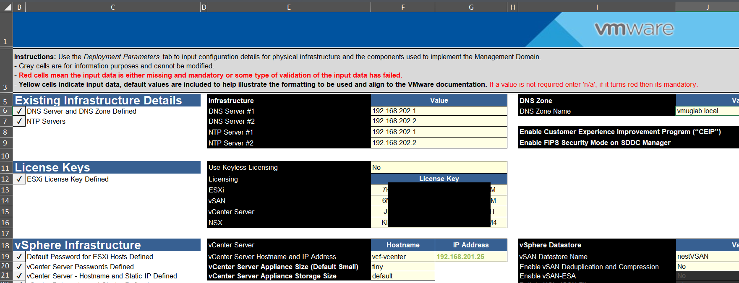
Tales from a Broadcom Customer in 2025
If I purchase VCF, do I need to run the entire Software-Defined Datacenter?

Slide 32
Tales from a Broadcom Customer in 2025
What’s no longer available?
vSphere Essentials Plus Kit
vSphere ROBO (all editions)
vRealize ROBO (all editions)
VSAN ROBO (all editions)
vSphere for Desktop
Omnissa Customers use VVF for VDI
Citrix Customers may purchase other levels (VCF, VVF, Enterprise Plus, Standard)
Enterprise License Agreement “Stated Out Years”

Slide 33
Tales from a Broadcom Customer in 2025
Our products in our last perpetual agreement
Perpetual Products
vSphere Enterprise Plus
vCenter Server
Aria Operations Suite Standard
VMware NSX Enterprise Plus
VMware vSphere for Desktop
vSphere ROBO Standard (per VM)
~1000 cores (not including VDI)
Replacement Products
VCF, VVF
VCF, VVF
VCF, VVF
VCF (would lose NSX if we downgraded to VVF)
VVF for VDI (from Omnissa)
vSphere Standard (per core) or VCF Edge (per core)

Slide 34
Tales from a Broadcom Customer in 2025
Contract Year | Type | Increase since 2016 | Increase vs Inflation | Year over Year Increase
2016 | ELA Year 1 (Added VROPS) | 0.00% | 0.00% | 0.00%
2017 | ELA Year 2 | 0.00% | -2.44% | 0.00%
2018 | ELA Year 3 | 0.00% | -4.42% | 0.00%
2019 | ELA Stated Out Year | 0.00% | -5.88% | 0.00%
2020 | Off the shelf / Shrink Infra | 18.52% | 8.85% | 18.52%
2021 | ELA year 1 (Added NSX+Hor) | 10.91% | 0.45% | -6.42%
2022 | ELA year 2 | 10.91% | -6.54% | 0.00%
2023 | ELA year 3 | 10.91% | -12.17% | 0.00%
2024 | ELA year 4 | 10.91% | -14.80% | 0.00%
2025-2030 | Subscription | -8.00% | -31.04% | -16.63%

Slide 35
Tales from a Broadcom Customer in 2025
Finding the good in change
Increased our Aria Operations to Enterprise
Now entitled to Aria for Logs, Automation, Network, VSAN
No longer need to purchase VMware Workstation or Fusion
No longer required to sit a class to get certified
VMware Education is now included for free

Slide 36
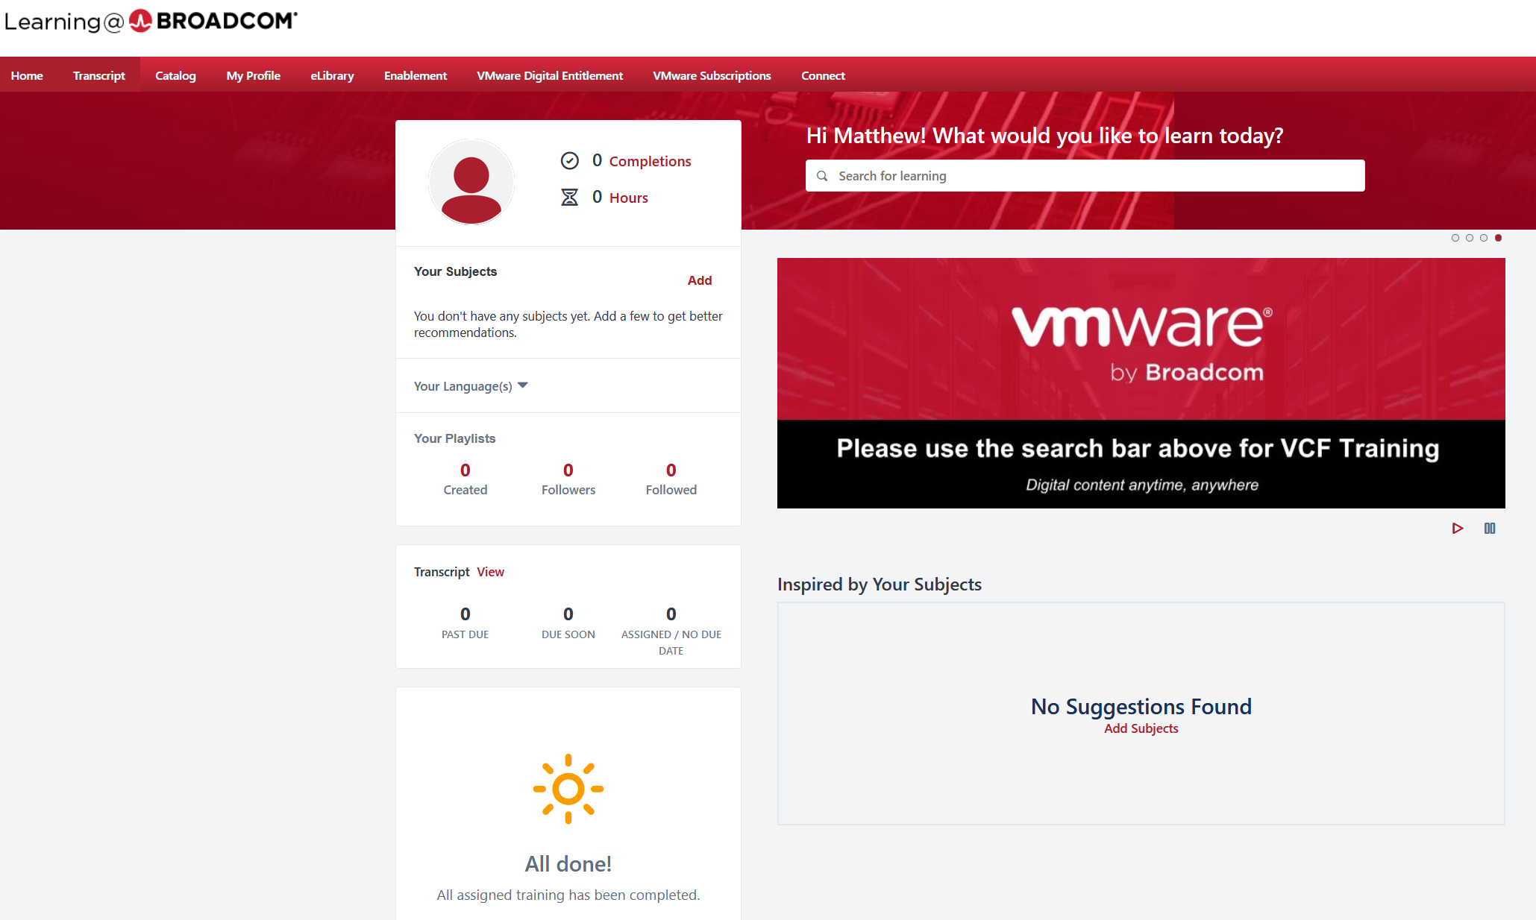

Tales from a Broadcom Customer in 2025
Help in getting access
To the Broadcom eLibrary

Slide 37
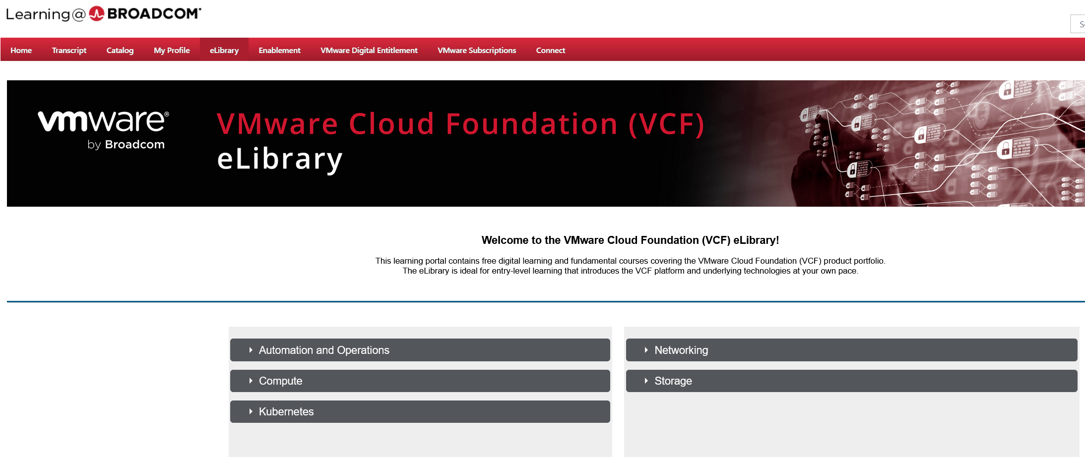
Tales from a Broadcom Customer in 2025

Slide 38
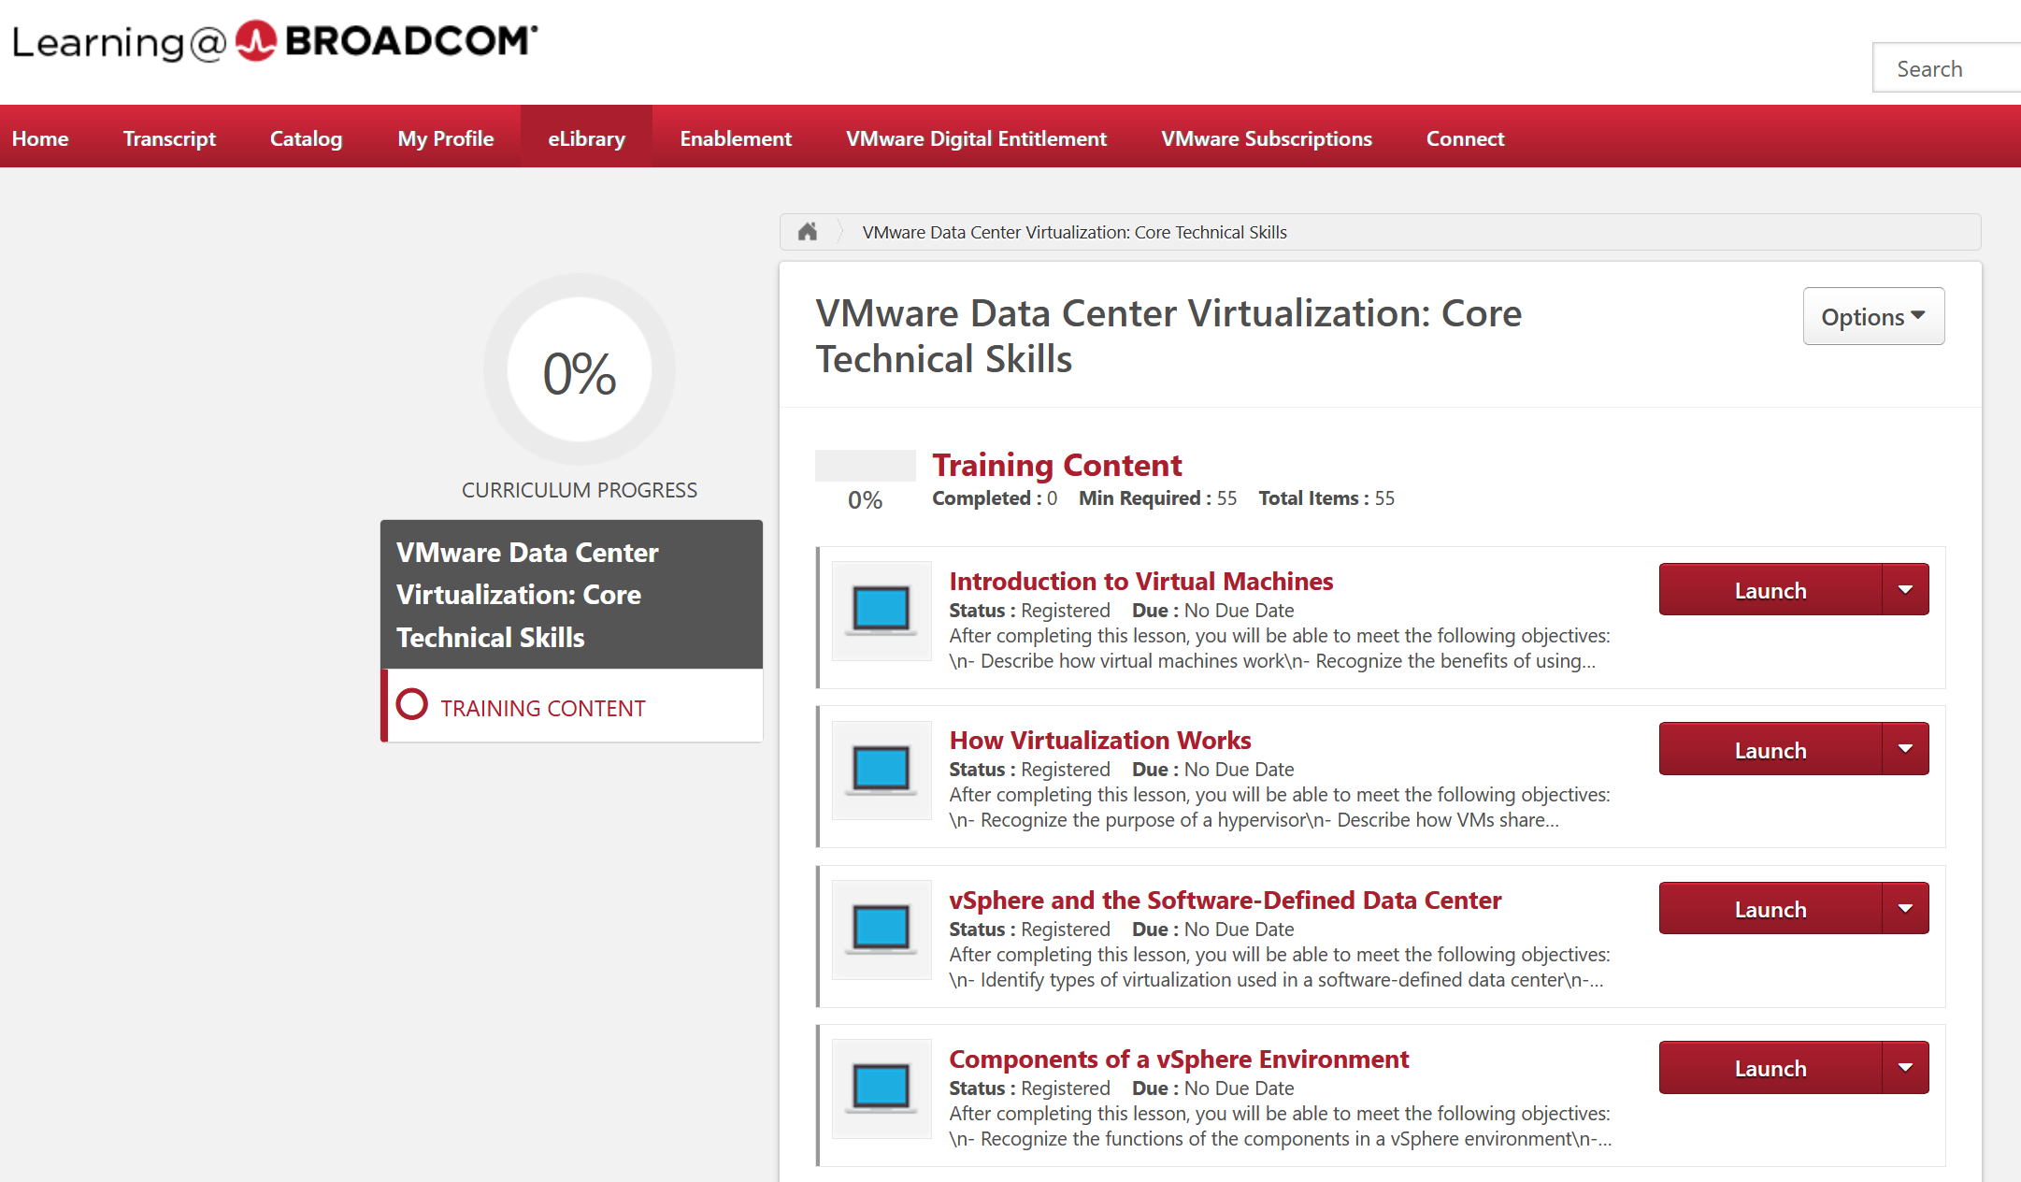
Tales from a Broadcom Customer in 2025

Slide 39
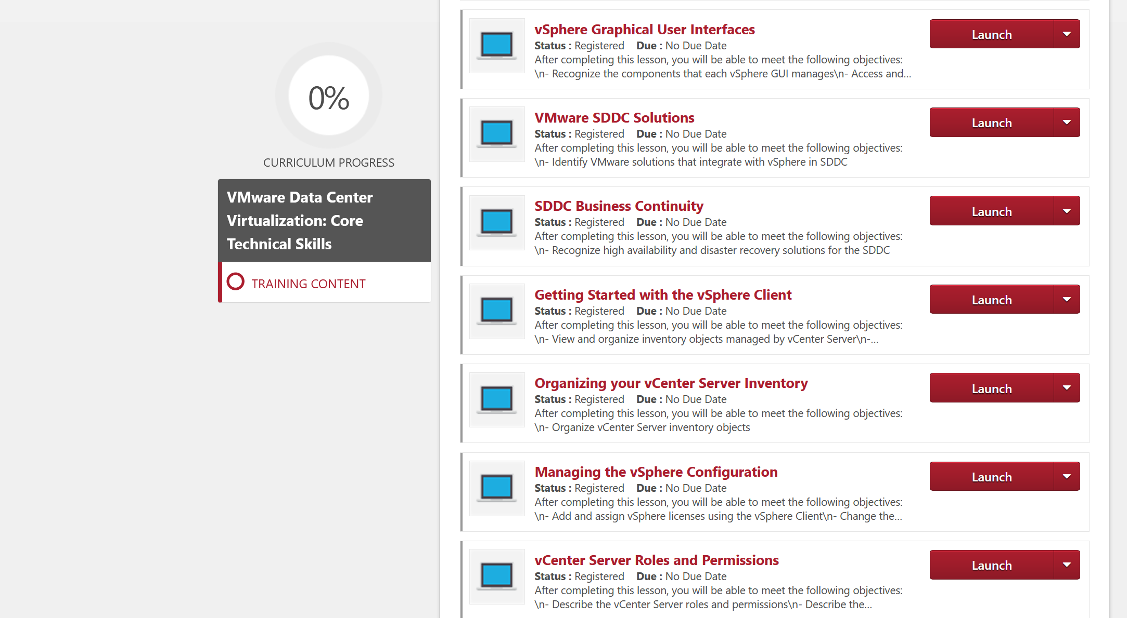
Tales from a Broadcom Customer in 2025

Slide 40
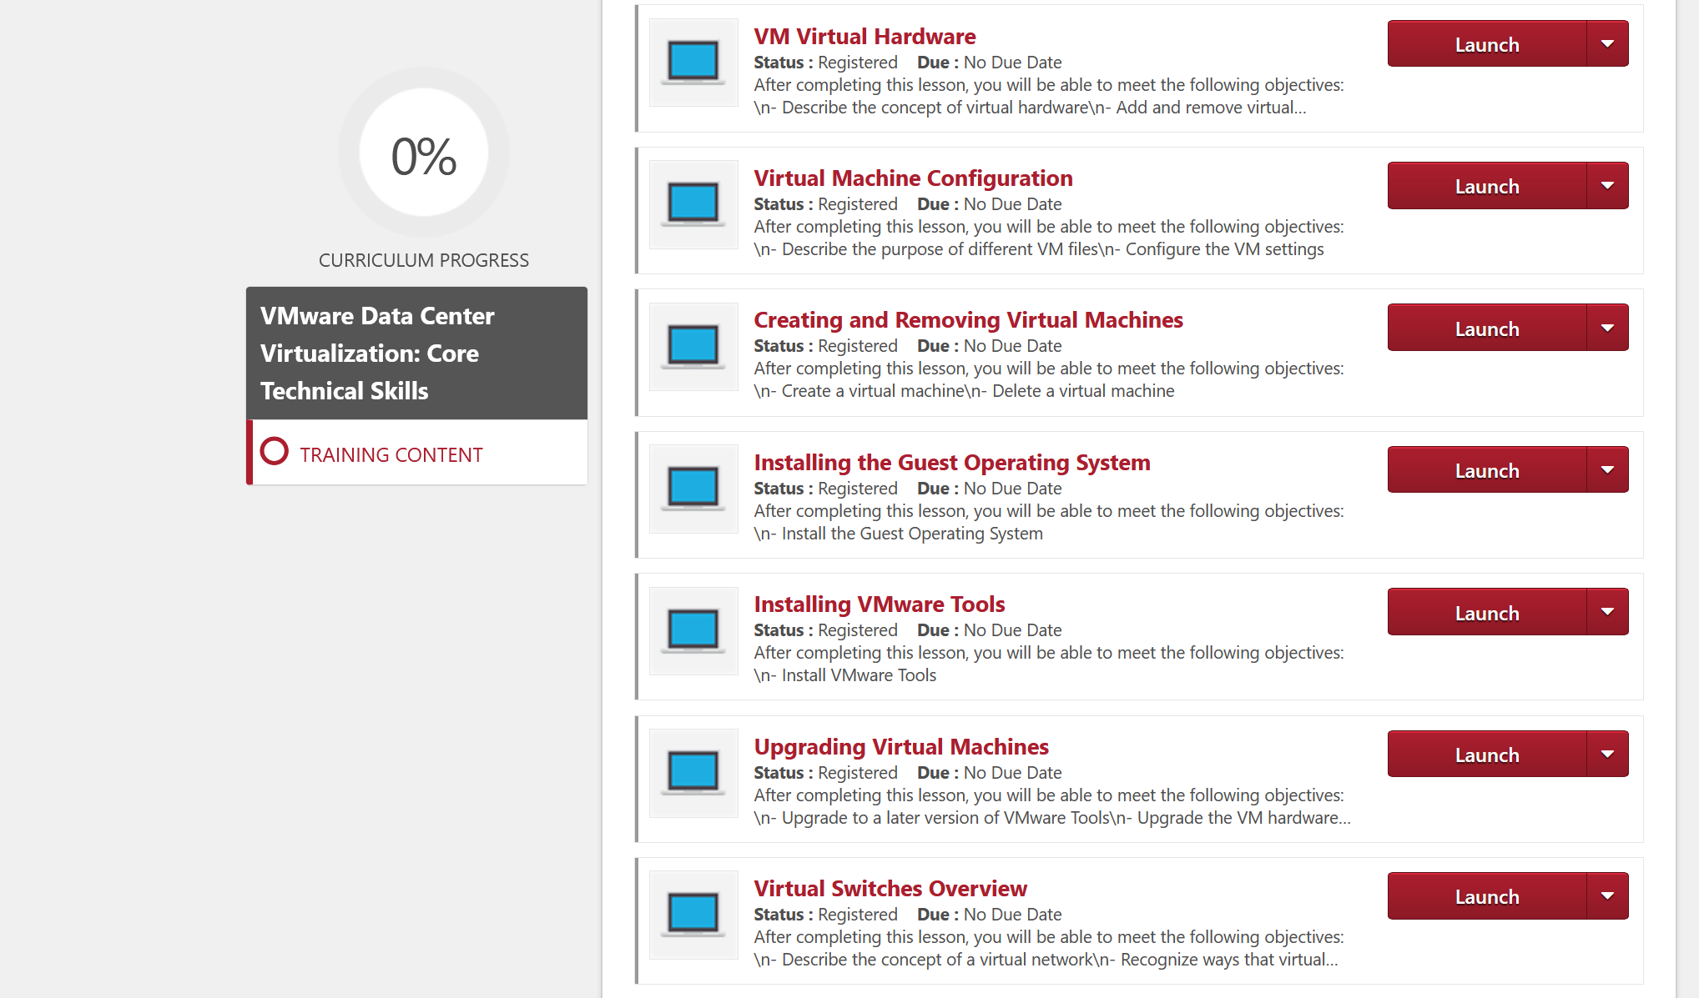
Tales from a Broadcom Customer in 2025

Slide 41
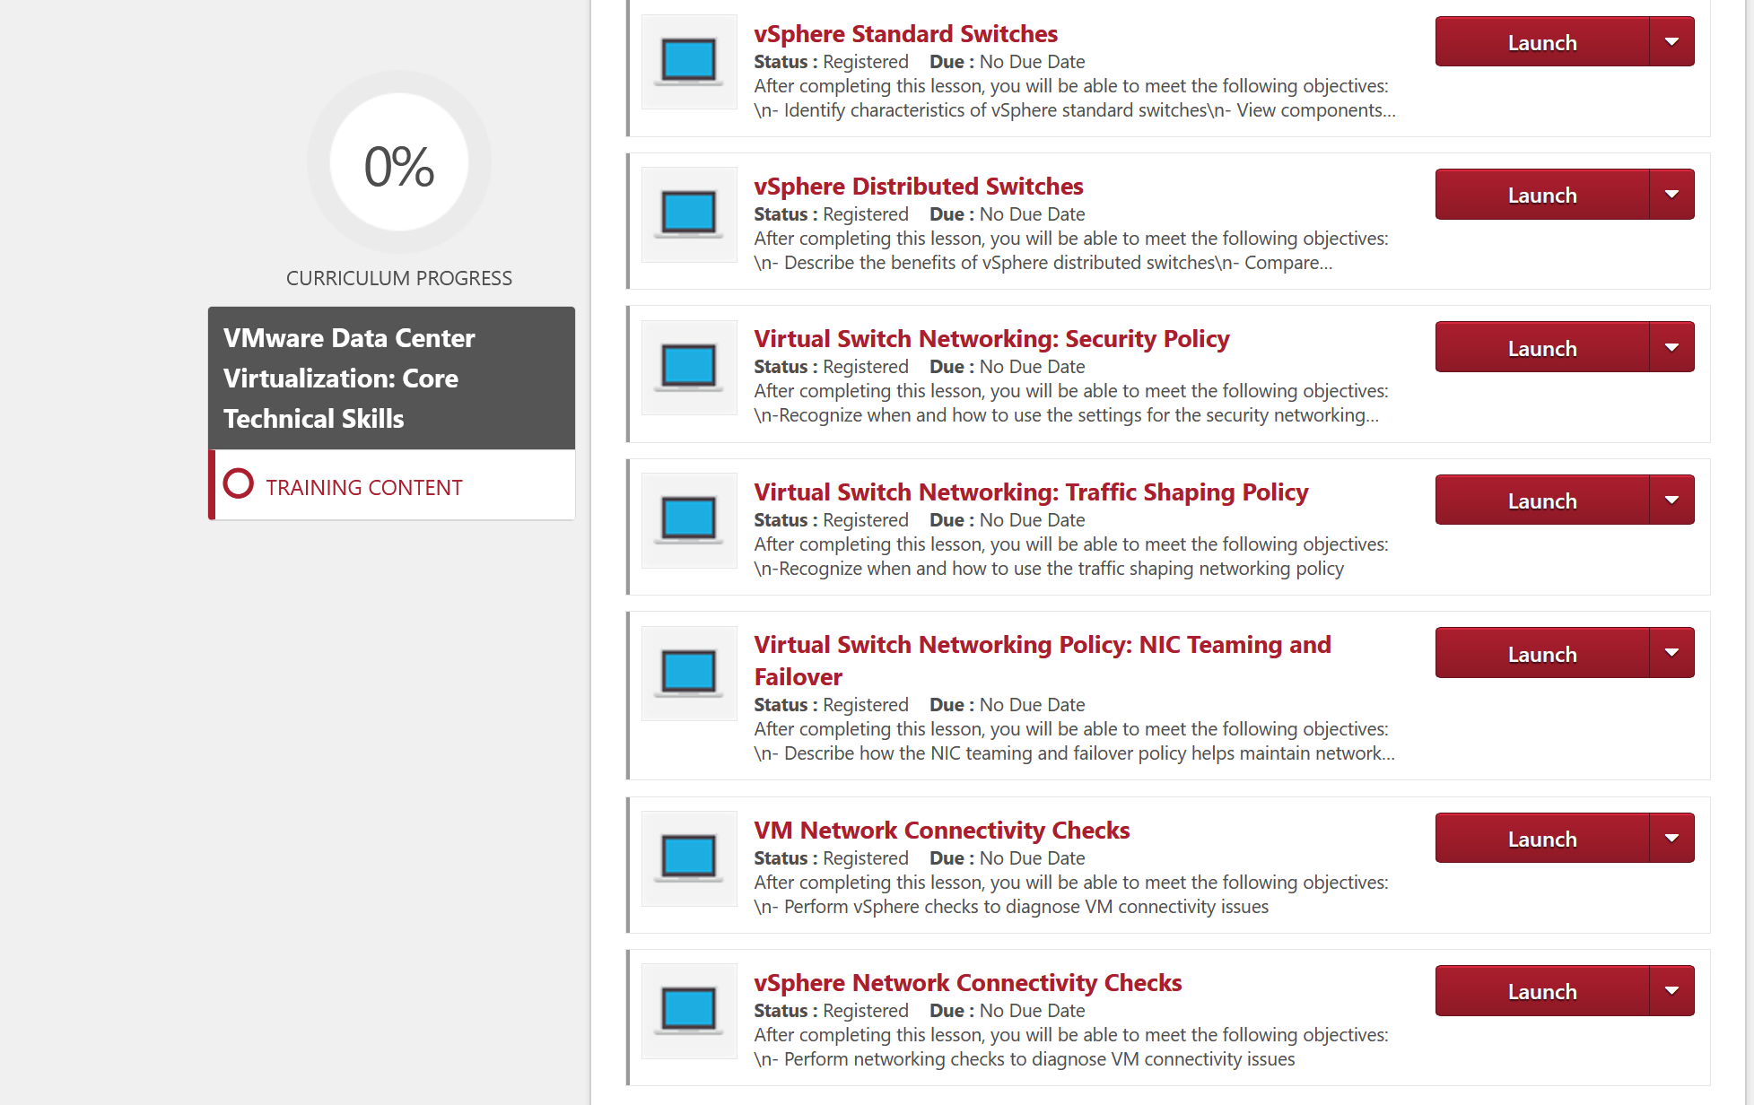
Tales from a Broadcom Customer in 2025

Slide 42
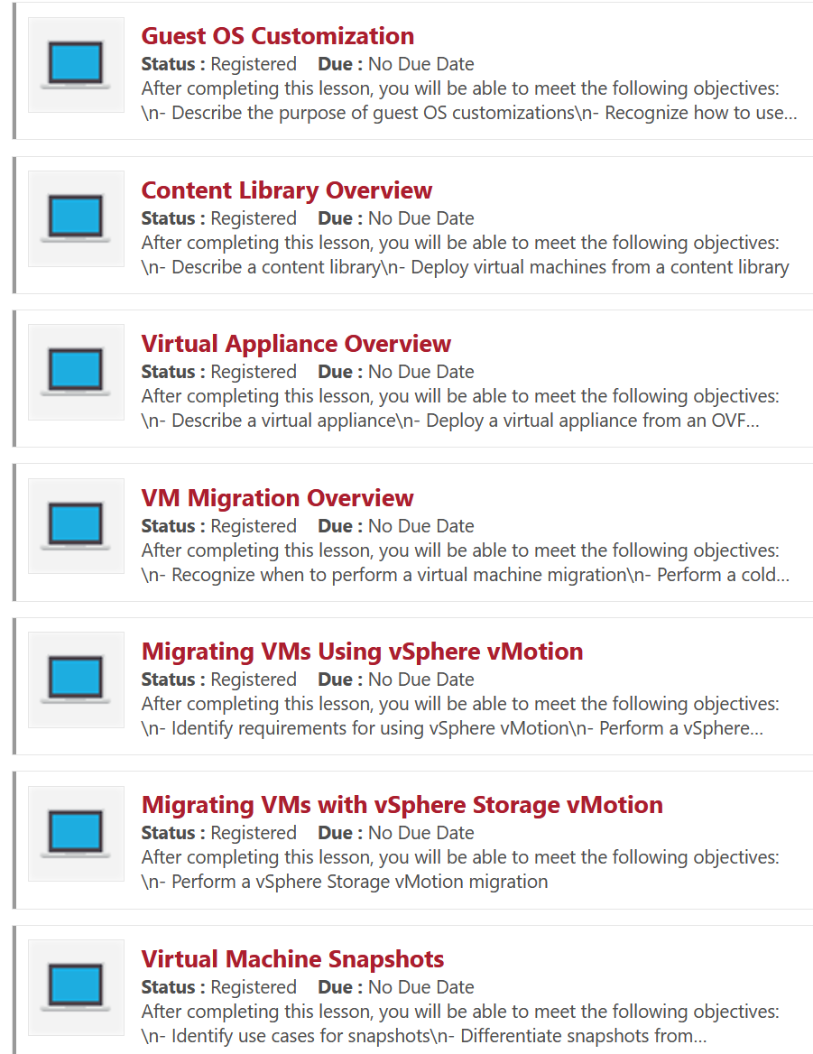
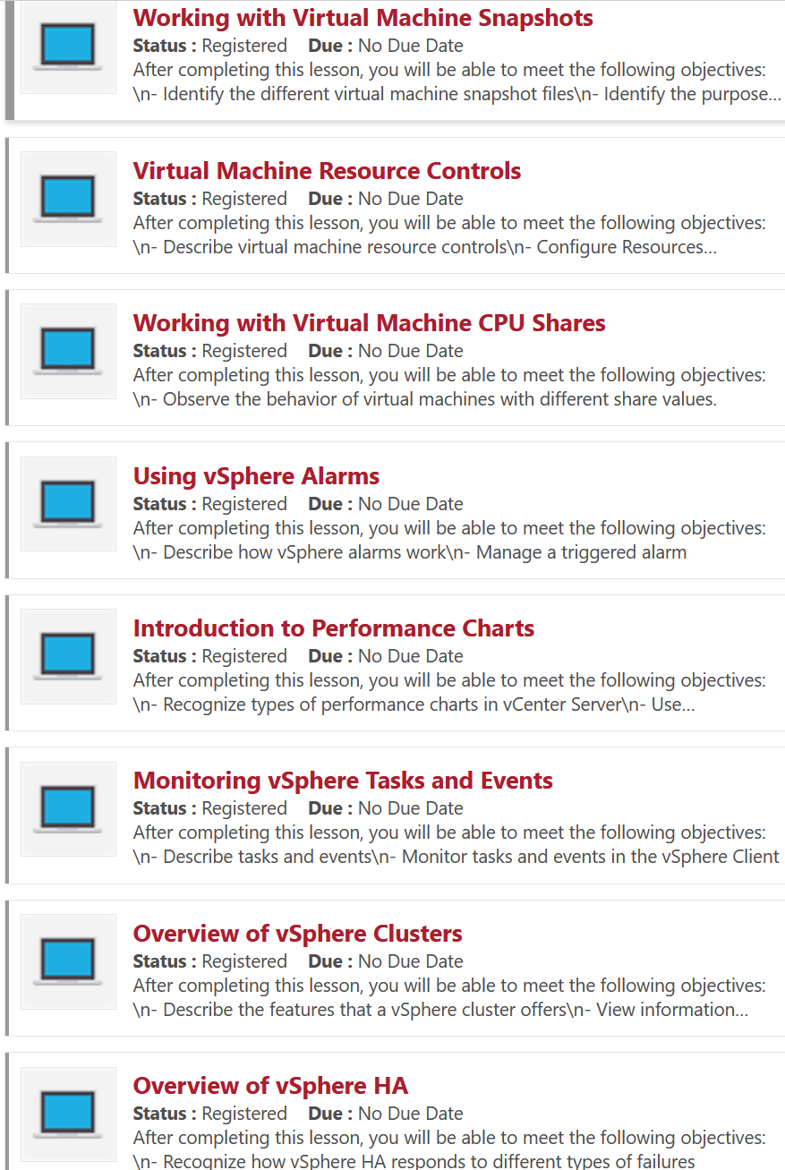
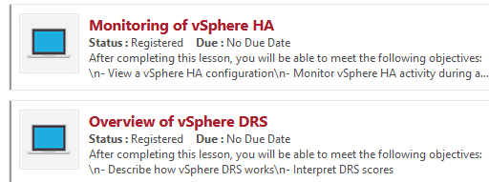
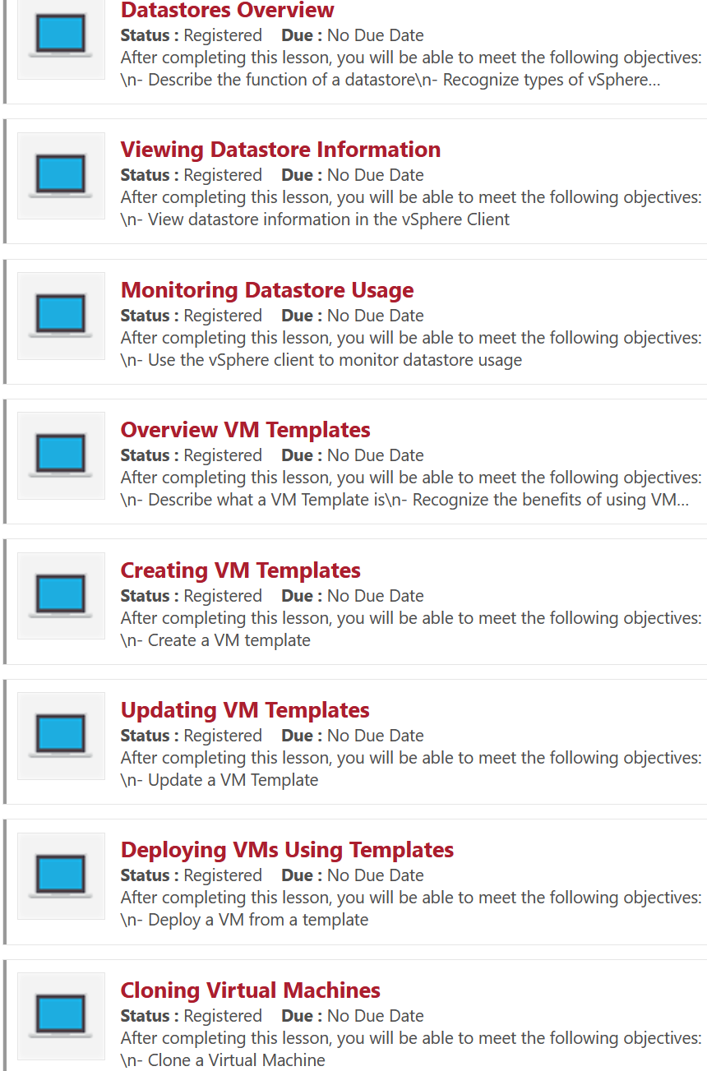
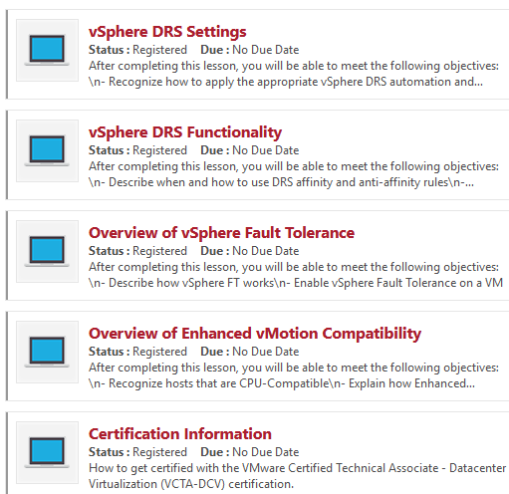
Tales from a Broadcom Customer in 2025

Slide 43
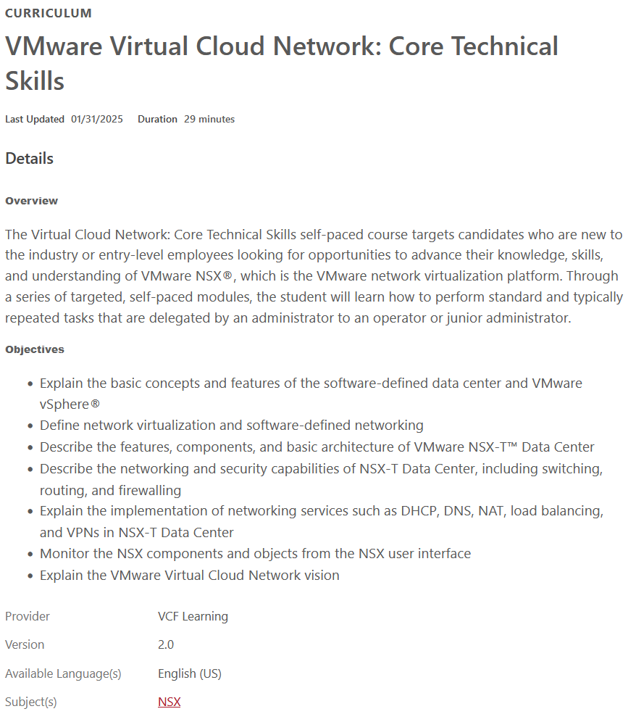
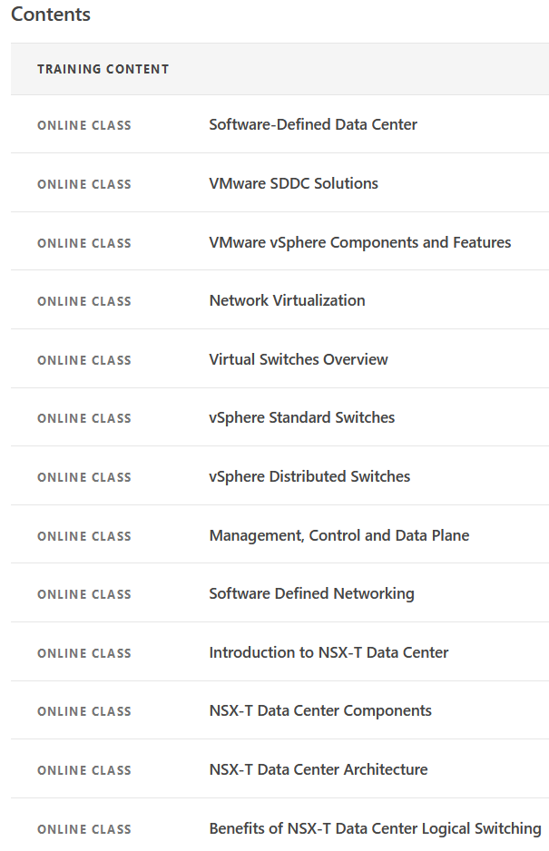
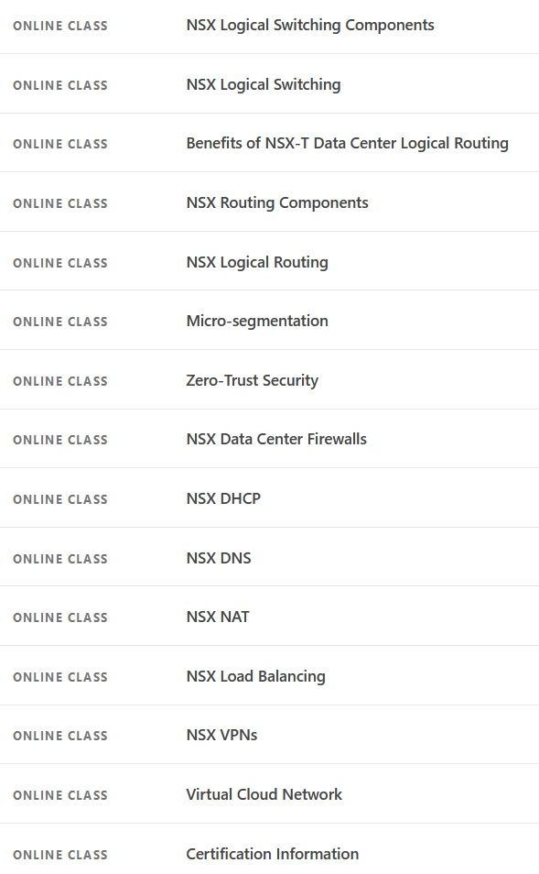
Tales from a Broadcom Customer in 2025

Slide 44
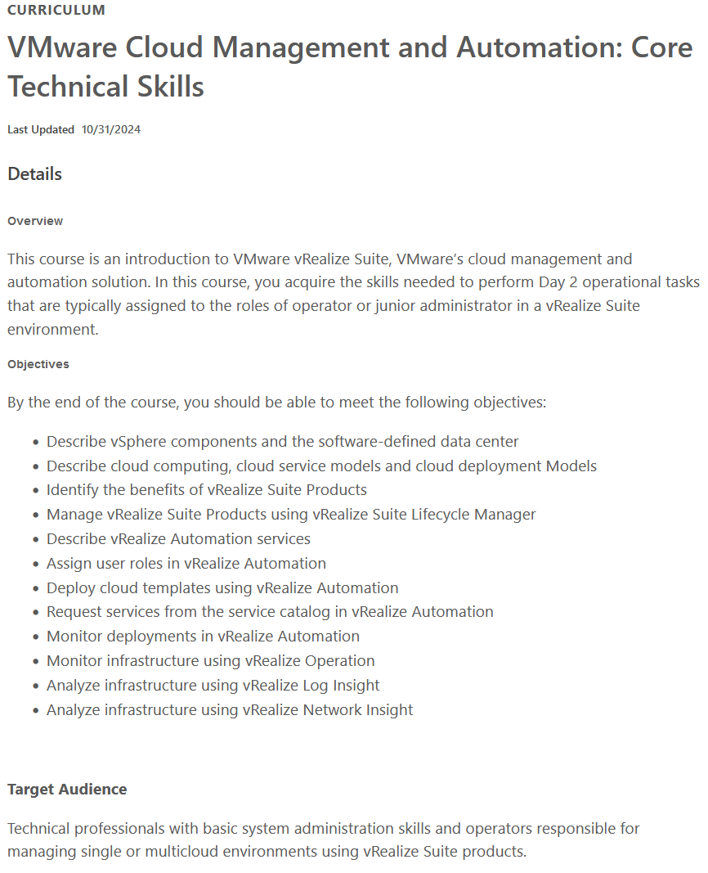
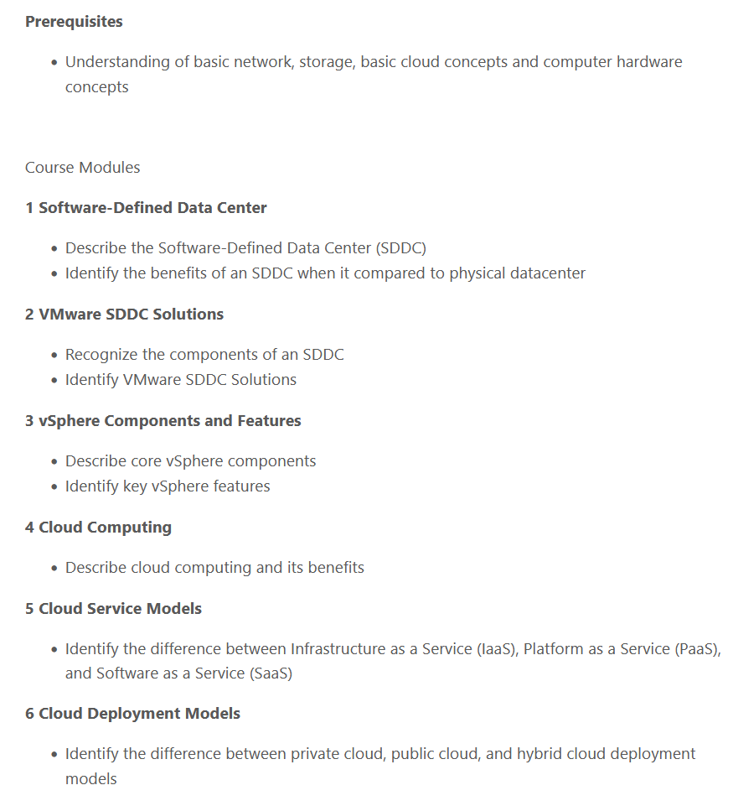
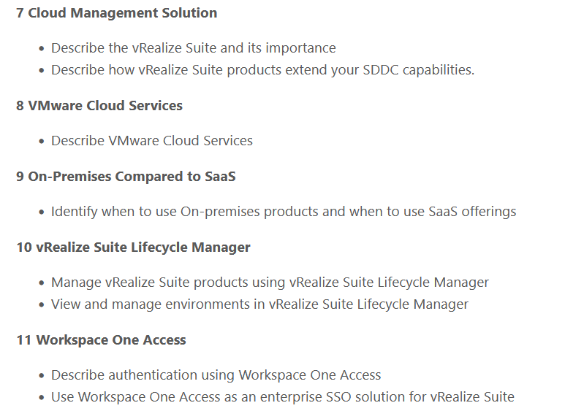
Tales from a Broadcom Customer in 2025

Slide 45
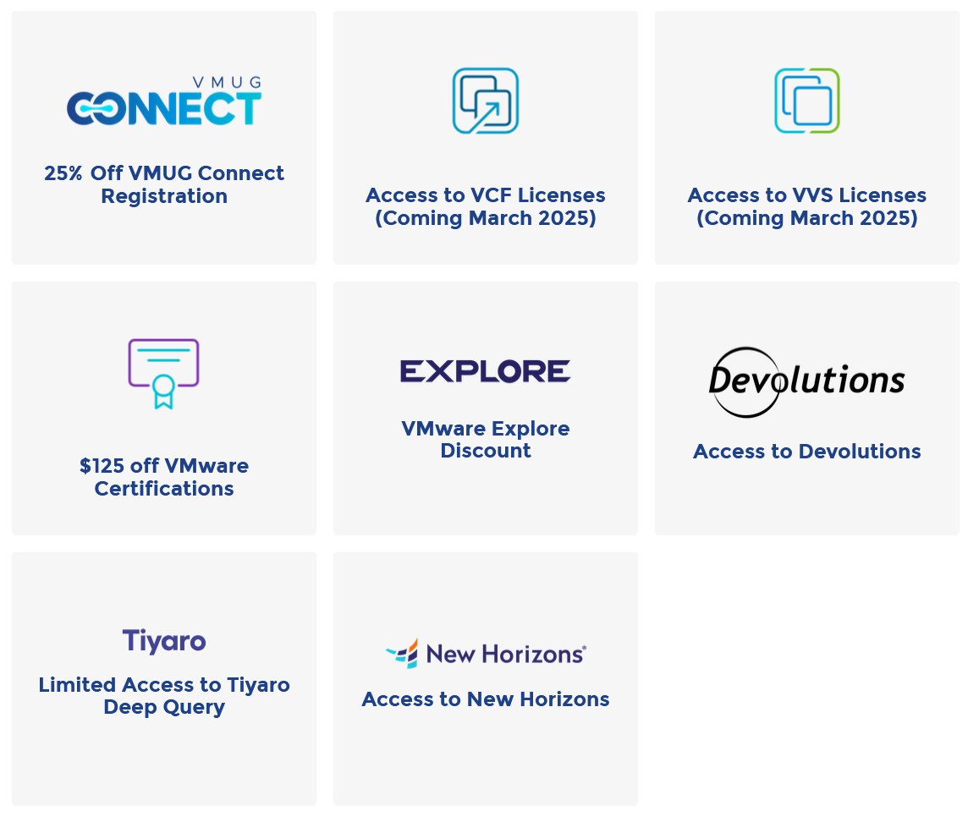
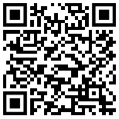
Tales from a Broadcom Customer in 2025
Impacts to VMUG Advantage and EvalExperience
Certifications
Required
VMUG Advantage
Information Page
VCP-VCF Administrator
VCP-VCF Architect
128 cores of VCF
VCP-VVF Administrator
32 cores of VVF

Slide 46
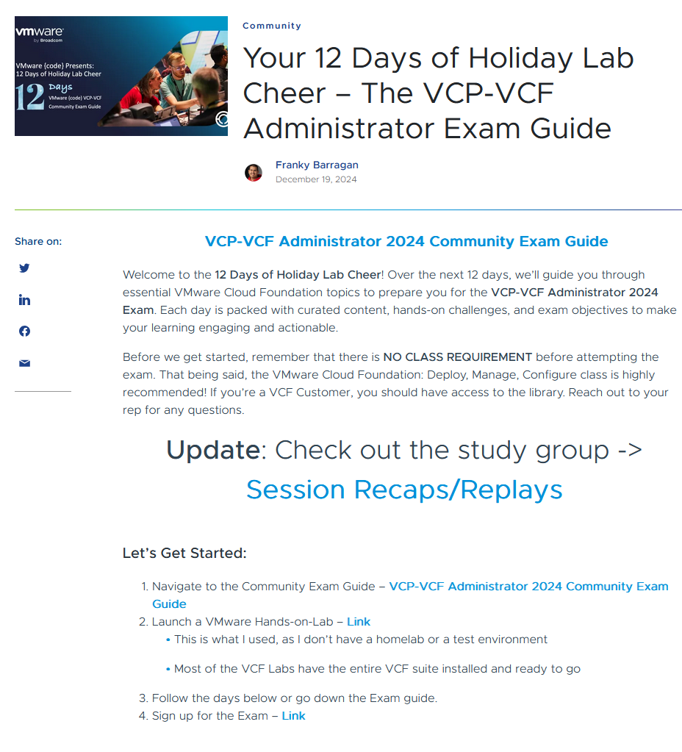
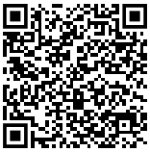
Tales from a Broadcom Customer in 2025
Ways to help you get certified
Day 1: Introduction to VMware Cloud Foundation Components
Day 2: Implementing Private Cloud Solutions
Day 3: VMware Aria Suite and vSphere IaaS Control Plane
Day 4: Data Services and Add-Ons
Day 5: Installation and Configuration of VMware Cloud Foundation
Day 6: Deploying and Configuring the Management Domain
Day 7: Backup, Certificate, and Password Management
Day 8: Deploying and Configuring NSX Edge Cluster
Day 9: VMware Aria Suite Deployment
Day 10: Troubleshooting VMware Cloud Foundation
Day 11: Day 2 Operations and Lifecycle Management
Day 12: Optimizing VMware Cloud Foundation
VMware {code}
12 days of Holiday Lab Cheer

Slide 47
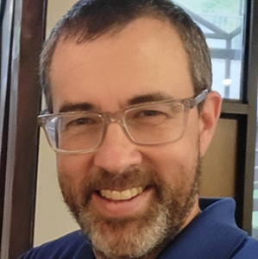
What about me?
The Challenge

Slide 48
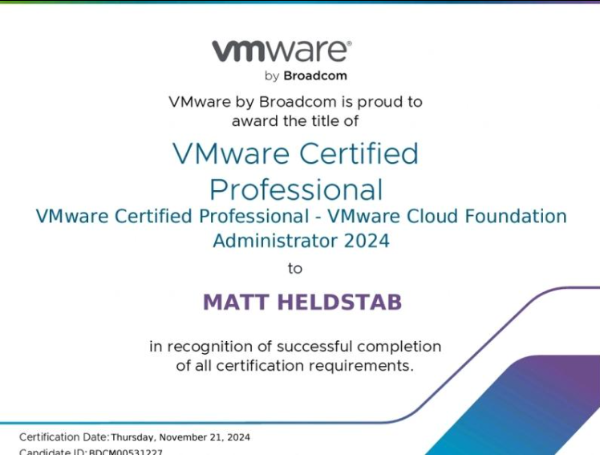
I forgot how great certification feels!

Slide 49
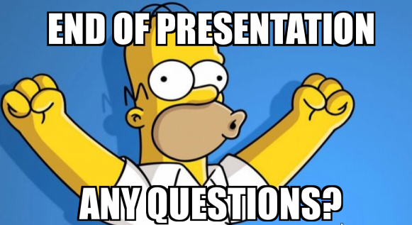
Link to Presentation
on my GitHub

Slide 52







Elements

